Slide 1

Unit-3: Multiple access in Wireless System
Mobile Computing Wireless Communication
(MCWC)
GTU # 2170710
PART-3 : Wi-MAX and Mobile IP
Prof. Swati R Sharma
Computer Engineering Department
swati.sharma@darshan.ac.in
(O) 9727747317

Slide 2
Wireless System Operations Wi-MAX

Looping
Topics to be covered
Cordless Systems
Wireless Local Loop
WiMAX and IEEE 802.16 Broadband
Wireless Access Standards

Slide 3
Cordless System

Slide 4
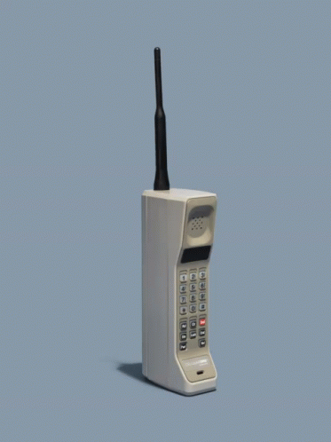
Cordless System
Cordless system is a general term of cordless telephones and cordless telecommunication systems.
Cord means a wire, so, a cordless system means wireless system.
A cordless telephone is known as a portable telephone and it acts as a standard phone.
A base station communicates with the cordless handset through radio waves, and this usually only works within a limited range like residence or office.
Example: Digital Enhanced Cordless Telecommunications (DECT) Phone

Slide 5
Wireless Local Loop - WLL

Slide 6
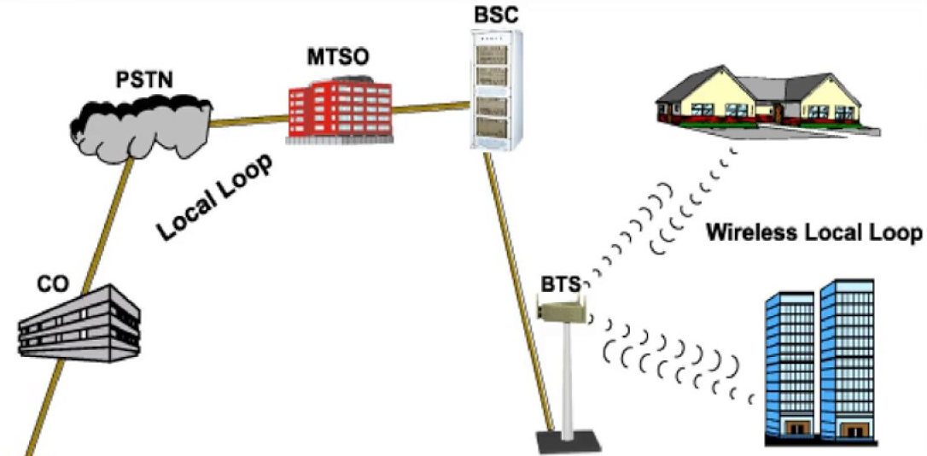
Wireless Local Loop - WLL
WLL is a system that connects subscribers to the local telephone station wirelessly.
In telephone, a loop is circuit line from subscriber’s phone to line-terminating equipment at the central office.
Implementation of a local loop especially in rural areas used to remain a risk for many operators due to fewer users and increased cost of materials.
So, Wireless local loop (WLL) has introduced which solves most of these problems.
It is also known as fixed wireless systems.

Slide 7
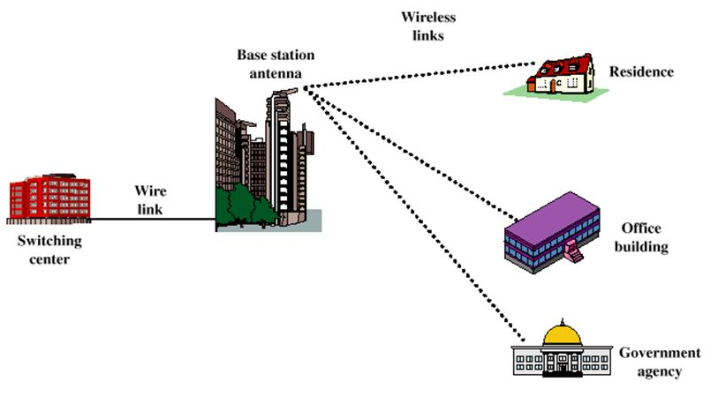
Advantages of WLL
It eliminates the first mile or last mile construction of the network connection.
No use of conventional copper wires, thus Low cost
Highly secured due to digital encryption techniques used in wireless communication.
Highly scalable as it doesn’t require the installation of more wires for scaling it.

Slide 8
Features of WLL
Internet connection via modem
Data service
Voice service
Fax service

Slide 9
WiMAX and IEEE 802.16

Slide 10
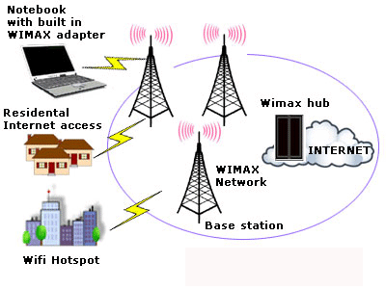
WiMAX and IEEE 802.16
Wireless Broadband known as Wireless Metropolitan Area Network (Wireless MAN) / Wireless Interoperability Microwave Access (WiMAX).
IEEE 802.16 standard released in April 2002.
It offers an alternative to high bandwidth wired access networks like fiber optic, cable modems and DSL.
It provides network access to buildings through exterior antennas communicating with radio base stations.
Networks can be created in just weeks by deploying a small number of base stations on buildings or poles to create high capacity wireless access systems.

Slide 11
IEEE Standards
IEEE 802.11 | Wireless LAN
IEEE 802.15 | Wireless Personal Area Network(WPAN)
IEEE 802.16 | Broadband Wireless Access (BBWA)
IEEE 802.20 | Mobile Broadband Wireless Access (MBWA)

Slide 12
Sub-standards of IEEE 802.16
IEEE 802.16.1 - Air interface for 10 to 66 GHz
IEEE 802.16.2 - Coexistence of broadband wireless access systems
IEEE 802.16.3 - Air interface for licensed frequencies, 2 to 11 GHz

Slide 13
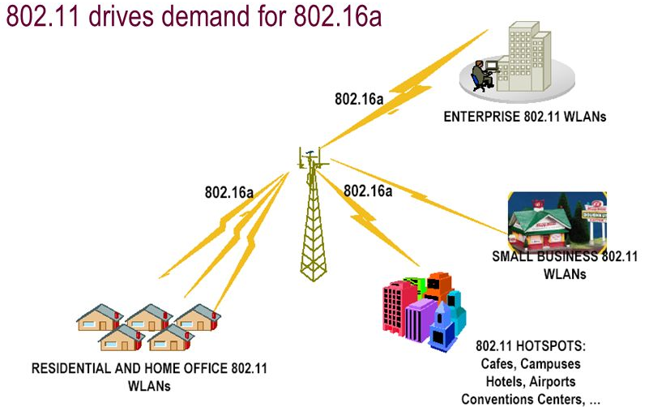
IEEE 802.16
The 802.16a standard for 2-11 GHz is a wireless metropolitan area network (MAN) technology that will provide broadband wireless connectivity to
Fixed
Portable
Nomadic devices (portable electronic devices for information, entertainment, or communication that can be used outside of the vehicle and inside the vehicle)
It can be used to connect 802.11 hot spots to the Internet, provide campus connectivity, and provide a wireless alternative to cable and DSL for last mile broadband access.

Slide 14
Deployment of WiMax – IEEE 802.16
IEEE 802.16 standards define how wireless traffic will move between subscribers and core networks.
A subscriber sends wireless traffic at speeds ranging from 2M to 155M bits/sec from a fixed antenna on a building.
The base station receives transmissions from multiple sites and sends traffic over wireless or wired links to a switching center using 802.16 protocol.
Wireless or wired link using 802.16 protocol
Switching Center
Residential subscriber
ISP
Base Station
The switching center sends traffic to an ISP or public switched telephone network.

Slide 15
Mobile IP

Looping
Topics to be covered
WiFi vs WiMAX
Mobile IP
Wireless Application Protocol

Slide 16
WiFi vs WiMAX

Slide 17
WiFi vs WiMAX
Features | WiFi | WiMAX
IEEE Standard | IEEE 802.11x | IEEE 802.16
Data Rate | 300 Mbps | 70 Mbps
Transmission Range | 300 meter | 50Km
Transmission Range | 300 meter | 50Km
Application | WiFi is for LAN applications | WiMAX is for MAN applications
QoS | WiFi does not guarantee any Quality of Service (Qos) | WiMax guarantee Quality of Service (Qos)
Application | WiFi is for LAN applications | WiMAX is for MAN applications

Slide 18
Mobile IP

Slide 19
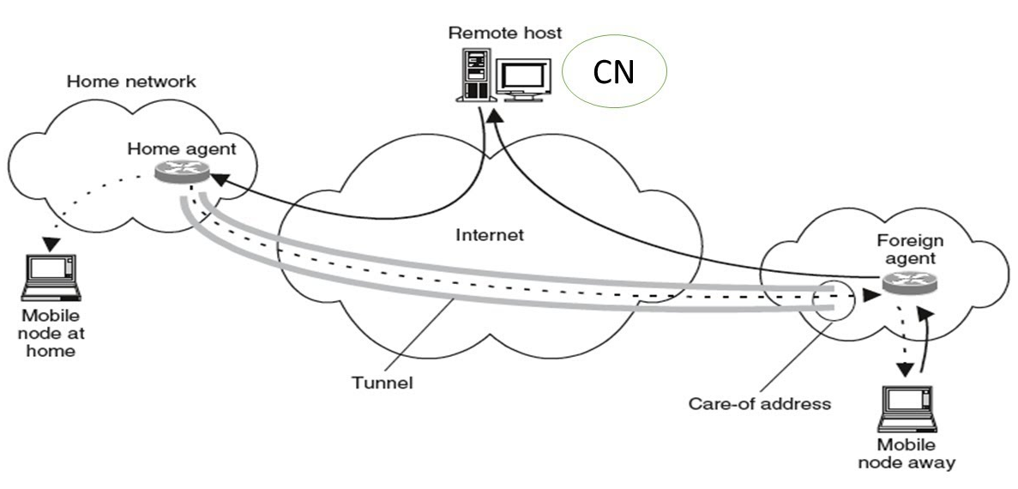
Mobile IP
Mobile IP is a communication protocol (created by extending Internet Protocol, IP) that allows the users to move from one network to another with the same IP address.
It ensures that the communication will continue without user’s sessions or connections being dropped.

Slide 20
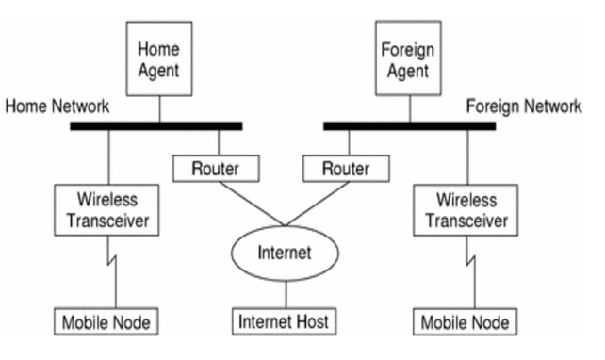
Mobile IP Topology

Slide 21
Mobile IP
The term “Mobile” in Mobile IP signifies that, while a user is connected to applications across the Internet and the user’s point of attachment changes dynamically, all connections are maintained despite the change in underlying network properties.
Similar to the handoff/roaming situation in a cellular network.
Mobile IP allows the mobile node to use two IP addresses called home address and care of address.
The home address is static and known to everybody as the identity of the host.
The care of address changes at each new point of attachment and can be thought of as the mobile node’s location specific address.

Slide 22
Mobile IP Architecture
Home Network for A
Foreign Network
Mobile Node A
4
3
Home Agent
Internet or other topology or routers and links
Foreign Agent
2
1
5
Server X
At foreign network, the incoming IP datagram is intercepted by the foreign agent.
The foreign agent is the counterpart of the home agent in the foreign network.
A uses X’s IP static address as the destination address in the IP header.
The IP datagram from A to X travels directly across the network, using X’s IP address as the destination address.
The IP datagram is routed to A’s home network. At the A’s home network, the incoming IP datagram is intercepted by the home agent.
For routing A’s IP datagram to X, each datagram is sent to some router in the foreign network. Typically, this router is the foreign agent.
Server X wants to transmit an IP datagram to node A.
The home address of A is advertised and known to X.
X does not know whether A is in the home network or somewhere else.
Therefore, X sends the packet to A with A’s home address as the destination IP address in the IP header.
A care of address has been allocated to A by this foreign network and available with the home agent.
The home agent encapsulates the entire datagram inside a new IP datagram, with A’s care of address in the IP header.
This new datagram with the care of address as the destination address is retransmitted by the home agent.
A intends to respond to this message and sends traffic to X.
In this example, X is not mobile; therefore X has a fixed IP address.
The foreign agent strips off the outer IP header, and delivers the original datagram to A.
The home agent discovers that A is in a foreign network.

Slide 23
Working of Mobile IP
Discovery - A mobile node uses a discovery procedure to identify prospective home agents and foreign agents.
Registration - A mobile node uses a registration procedure to inform its home agent of its care-of address.
Tunneling - Tunneling procedure is used to forward IP datagrams from a home address to a care of address.

Slide 24
Working of Mobile IP: Discovery
Discovery - A mobile node uses a discovery procedure to identify prospective home agents and foreign agents.
Agent Discovery
HA’s and FA’s broadcast their presence on each network to which they are attached
Beacon messages via ICMP (Internet Control Message Protocol)and RDP (Router Discovery Protocol)
MN’s listen for advertisement and then initiate registration

Slide 25
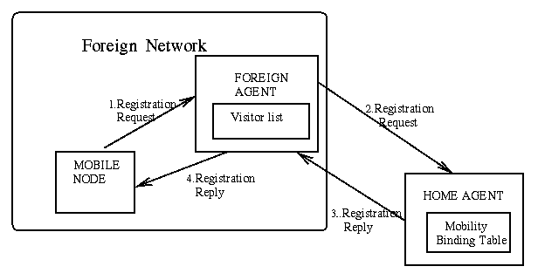
Working of Mobile IP: Registration Process
Registration - A mobile node uses a registration procedure to inform its home agent of its care-of address.

Slide 26
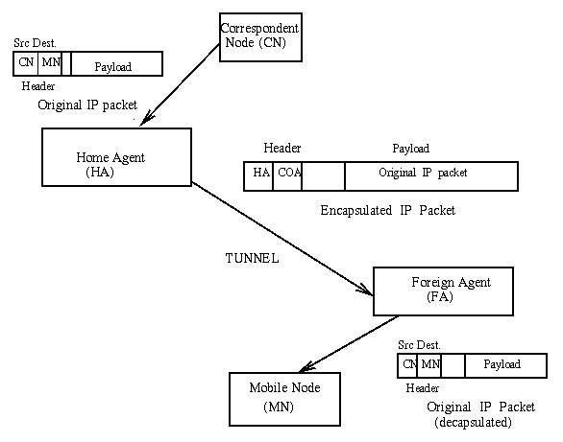
Working of Mobile IP: Tunneling
Tunneling - Tunneling procedure is used to forward IP datagrams from a home address to a care of address.

Slide 27
Mobile IP: Features
Enables hosts to stay connected to the Internet regardless of their location
Enables hosts to be tracked without needing to change their IP address
Requires no changes to software of non-mobile hosts/routers
Requires addition of some infrastructure
Has no geographical limitations
Requires no modifications to IP addresses or IP address format
Supports security

Slide 28
Wireless Application Protocol

Slide 29
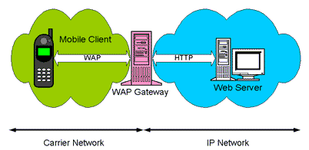
Wireless Application Protocol
WAP is an application communication protocol
It is designed for access to Internet and advanced telephony services from mobile phones
It is a protocol designed for micro-browsers and it enables the access of internet in the mobile devices
WAP uses mark-up language – WML
WAP can be used from variety of 2G and 3G networks
GPRS and 3G are more suited for these applications

Slide 30
WAP Protocol Stack

Slide 31
WAP Protocol Stack
Application Layer (WAE)
Other Services and Applications
Session Layer (WSP)
Transaction Layer (WTP)
Security Layer (WTLS)
Transport Layer (WDP)
Bearers:
GSM
IS-136
CDMA
PHS
CDPD
PDC-P
IDEN
FLEX
etc…
Wireless Application Environment
(WAE)
Wireless Transaction Protocol
(WTP)
Wireless Session Protocol
(WSP)
Wireless Transport Layer Security
(WTLS)
Wireless Datagram Protocol
(WDP)
It runs on top of a datagram service such as User Datagram Protocol (UDP) and is part of the standard suite of TCP/IP protocols used to provide a simplified protocol suitable for low bandwidth wireless stations.
WTP supports class of transaction service, optional user-to-user reliability, PDU concatenation and asynchronous transaction.
WTLS incorporates security features that are based upon the established Transport Layer Security(TLS) protocol standard.
It provides data integrity, privacy, authentication, denial of service protection.
Primary objective of WAE is to provide an interoperable environment to build services in wireless space.
Content is transported using standard protocols in the WWW domain and an optimized HTTP like protocol in the wireless domain.
Wireless Telephony Application: Telephony services and programming interface.
WAP Push Architecture which allow for mechanisms to allow origin servers to deliver content to the terminal without the terminal requesting for it.
WAE architecture allows all content and services to be hosted on standard Web Servers when all content is located using WWW standard URLs.
WAE enhances some of the WWW standards to reflect some of the telephony network characteristics.
Unlike HTTP, WSP has been designed by the WAP Forum to provide fast connection suspension and reconnection.
WSP provides a consistent interface between two session services like client and server.
WSP offers both connection-oriented and connectionless service.
WDP is transport layer protocol in WAP architecture.
WDP operates above data capable bearer services supported by various network type general transport service.
It allows WAP to be bearer-independent by adapting the transport layer of the underlying bearer.
The WDP presents a consistent data format to the higher layers of the WAP protocol stack.
User agent which is the browser or a client program.
Wireless Markup Language (WML) which is a lightweight markup language optimized for use in wireless devices.
WML Script which is a lightweight client side scripting language.

Slide 32
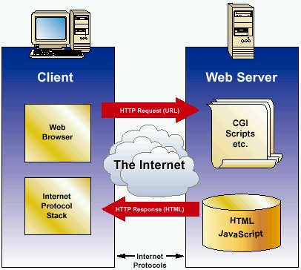
Comparing with Internet Model
HTML
HTTP
TLS/SSL
TCP/IP

Slide 33
WAP Architecture
Client
Web Server
WAP Gateway
WML
CGI
Scripts
etc.
WML Encoder
WML-Script
WSP/WTP
HTTP
WML Decks
with WML-Script
WMLScript
Compiler
WTAI
Protocol Adapters
Content
Etc.

Slide 34

References
Book: | Mobile Computing Technology, Applications and service creation , Asoke K Telukder, Roopa R Yavagal by TMH
Web: | https://www.electronics-notes.com/

Slide 35
Unit-3: Multiple access in Wireless System
Mobile Computing Wireless Communication
(MCWC)
GTU # 2170710
PART-3 : Wi-MAX and Mobile IP
Prof.Swati R Sharma
Computer Engineering Department
swati.sharma@darshan.ac.in
(O) 9727747317

